Slide 1
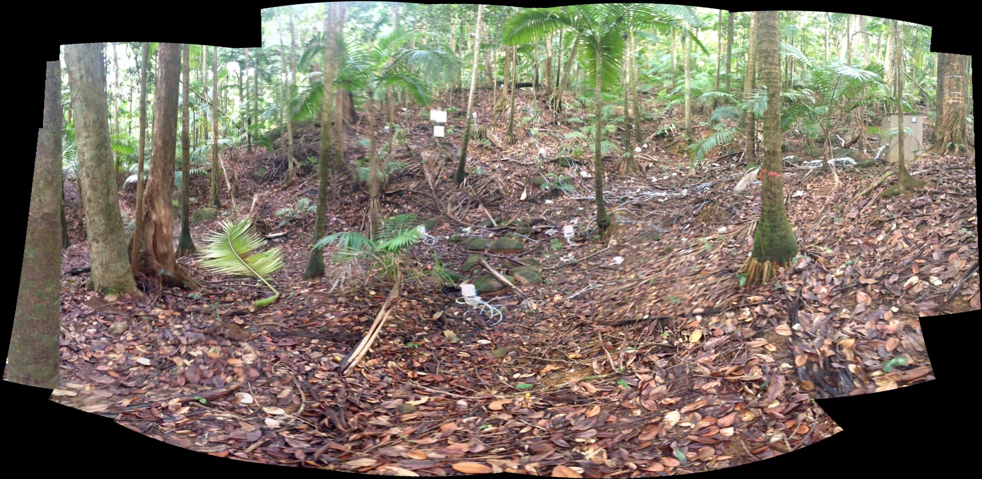
R1
S1
R2
S2
V1
V2
Ridge, slope and valley chambers
Outline of valley area
Possible locations of soil depth profiles (two options for each topographic location)

